Slide 1
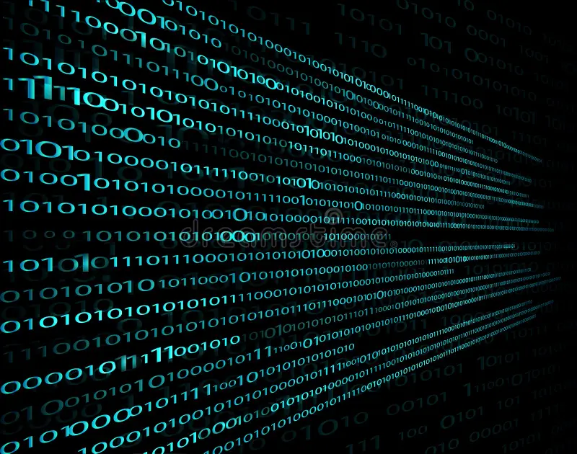

Data Representation in Computers

Slide 2

01
Binary System
Computers store all data using only 0s and 1s. These are called bits.
8 bits together make 1 Byte, which can store a small piece of information, like a letter or number.
Binary numbers are like the “language” of computers. Every number, letter, image, or file is turned into a sequence of bits so the computer can understand it.

Slide 3
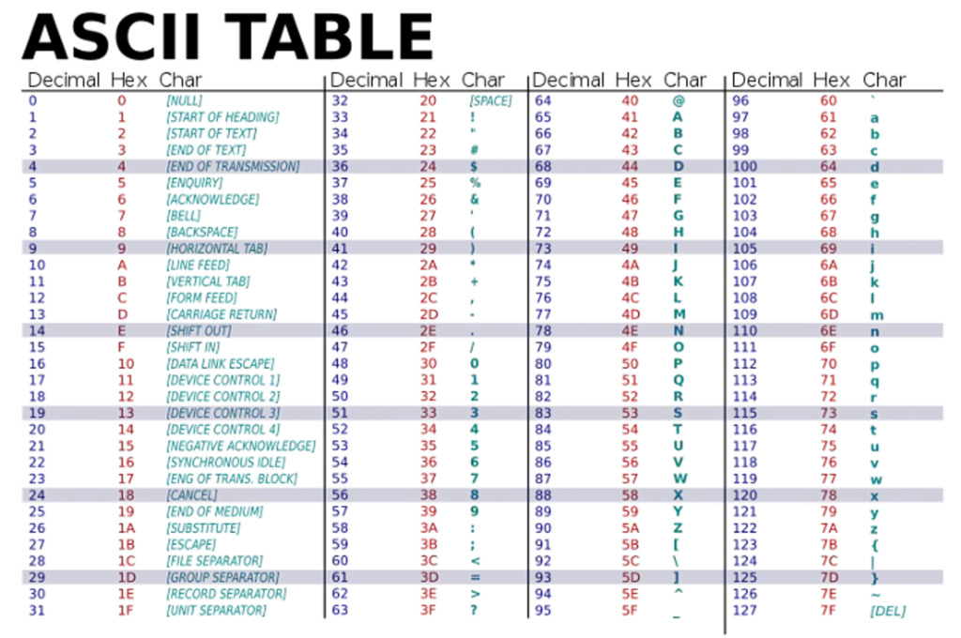
02
Characters (ASCII & Unicode)
ASCII is a system that gives each English letter, number, or symbol a unique binary code.
Unicode is bigger and can represent letters from all languages in the world.
Example: The letter A = 01000001 in ASCII.
Computers store every character as a number in binary. That’s how texts in documents, emails, and programs are saved digitally.

Slide 4

03
Images, Sound, and Video
Images: Each tiny dot (pixel) has a color, shown as numbers for Red, Green, and Blue (RGB).
Sound: Sounds are waves, but computers store them as sequences of numbers.
Video: A video is many images shown quickly with sound, all stored digitally.
Computers can show, edit, and play images, sounds, and videos because all of it is stored as 0s and 1s.

Slide 5


LOGO COMPANY
04
Conclusion & Sources
Conclusion: Everything on a computer – text, images, sound, and video – is represented using 0s and 1s.
Binary numbers are the foundation of all digital information.
Sources:
https://www.computerhope.com/jargon/b/binary.htm
https://www.tutorialspoint.com/computer_fundamentals/computer_data_representation.htm

Slide 6
Thank you

